Slide 1
SubC Compiler
Neil Majumdar, Rahul Krishan, Henry Trollinger, Caleb Nale
Notes:
Caleb, everyone

Slide 2
Source Language: subC
Our source language is influenced by C
We decided this because of its familiarity
It also shares some structural similarities with pascal, so we are able to re-use a lot of code.
Therefore, we decided to take our existing projects, and edit them so that they work for our new grammar
Notes:
Caleb

Slide 3
Differences between C and subC
Similar to how our pascal projects did not include all aspects of pascal, we made some changes to simplify C
Case statements can have multiple constants per case.
Functions must be defined where they are declared.
All global variable must be declared in main
No passing by reference, only values
We use compound statements for all statements, and consider single statements as a compound statement
Notes:
henry

Slide 4
GRAMMER

Slide 5
Data Types
Integer
Character
String
Double
Array
Void (Functions)
Notes:
Caleb/ Rahul

Slide 6
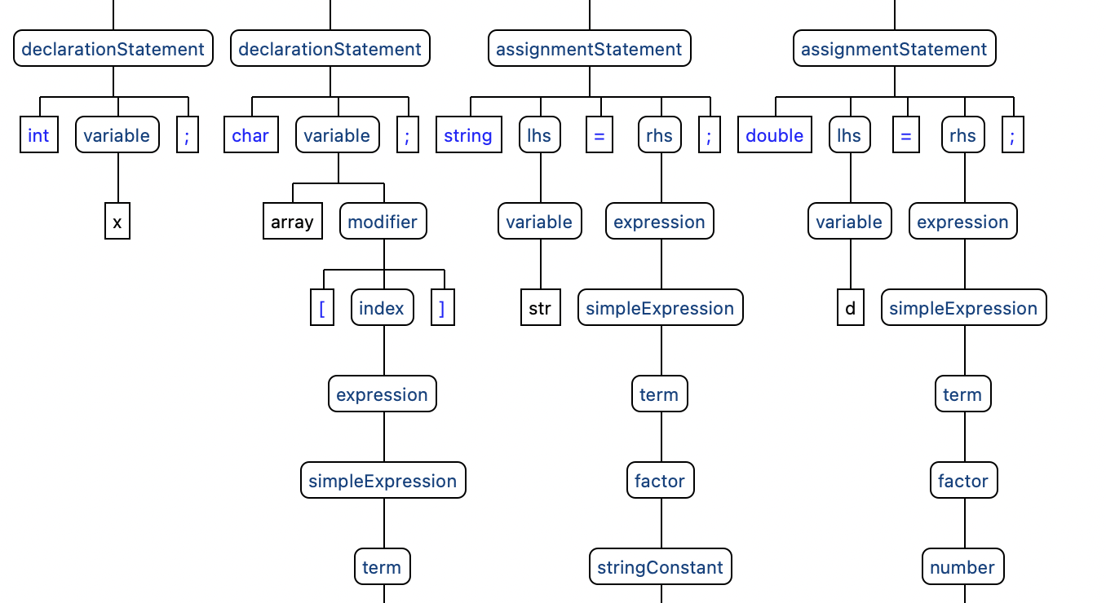
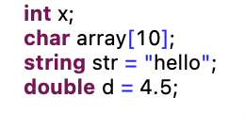
Notes:
Caleb/ Rahul

Slide 7
Control Statements
Notes:
Caleb/ Rahul

Slide 8
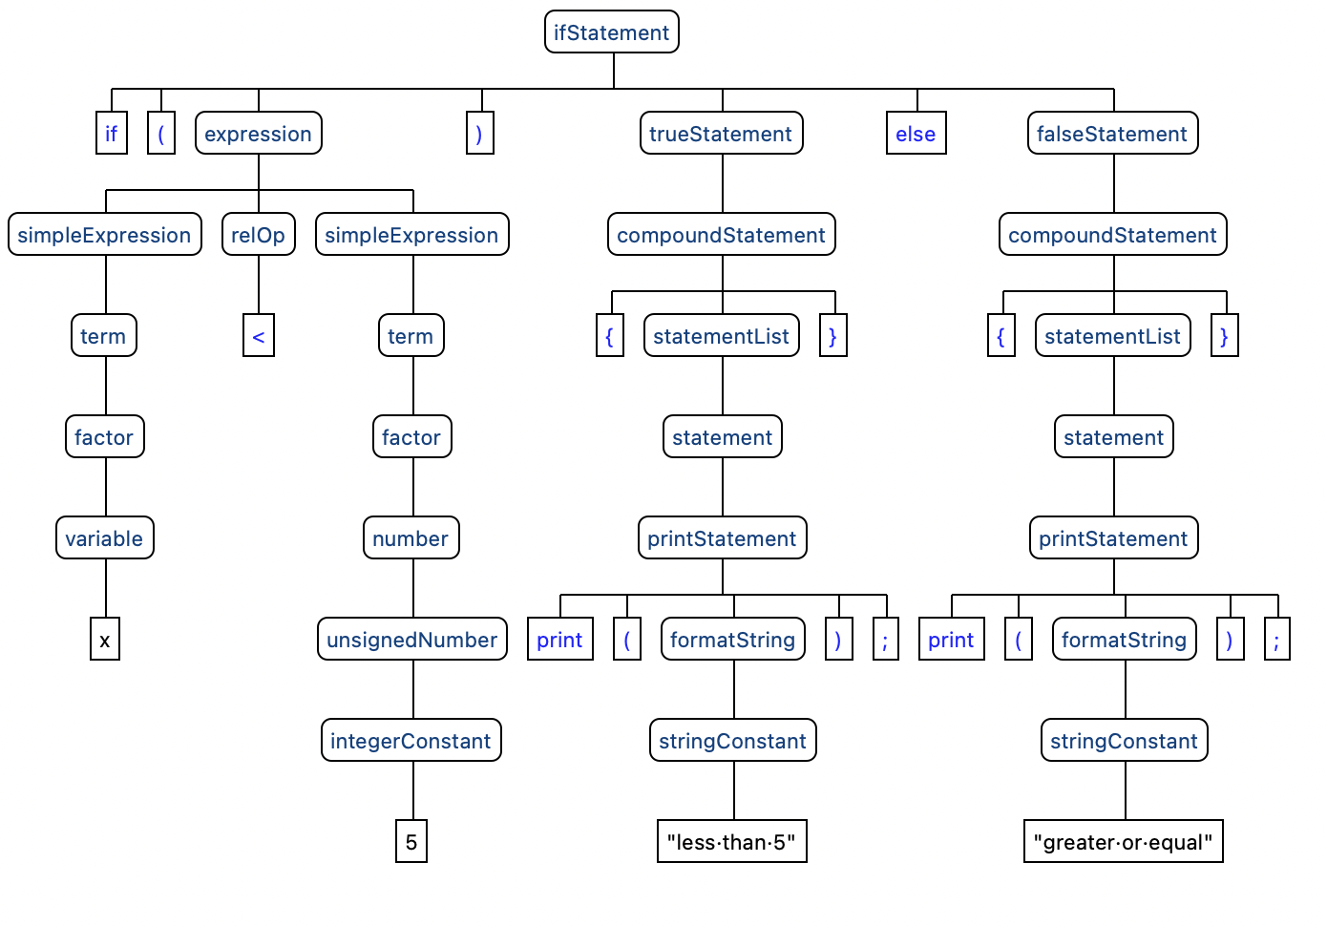
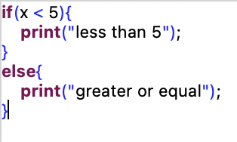
If

Slide 9
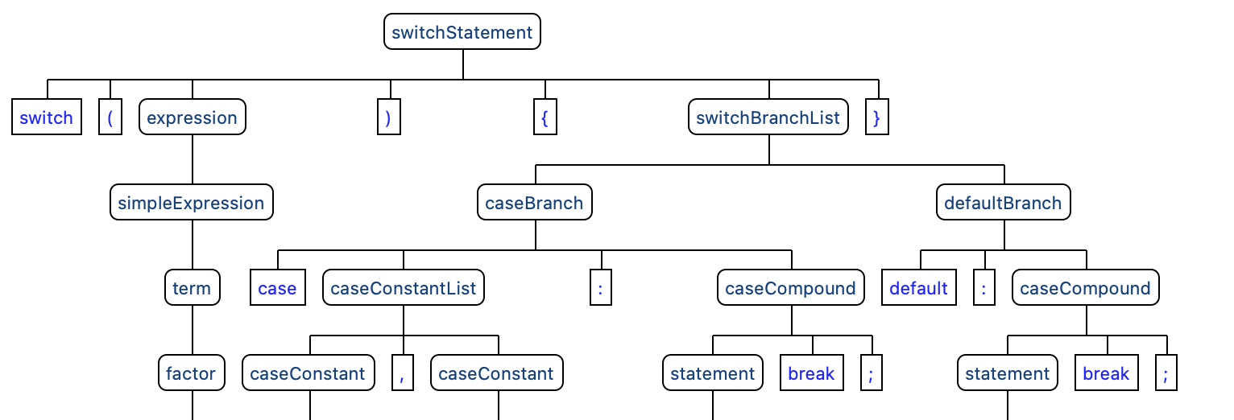
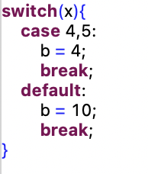
Switch

Slide 10
Loop Statements
Notes:
Caleb/ Rahul

Slide 11
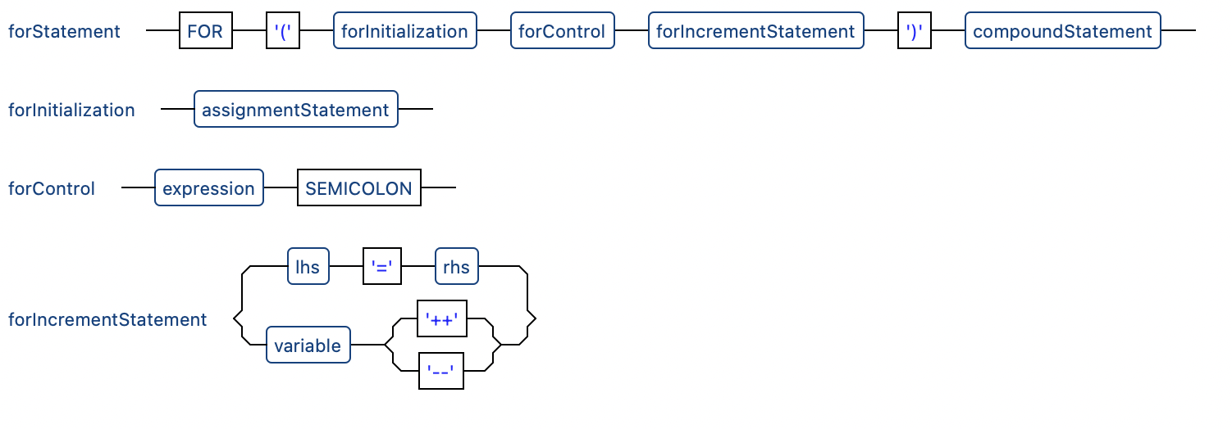
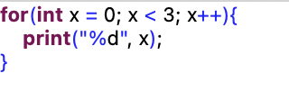
Grammar
Notes:
Caleb/ Rahul

Slide 12
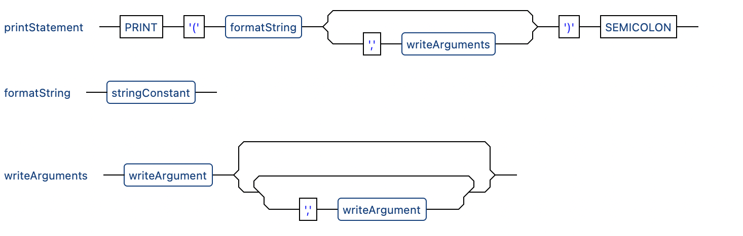
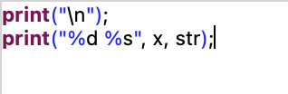
Print
Notes:
Caleb/ Rahul

Slide 13
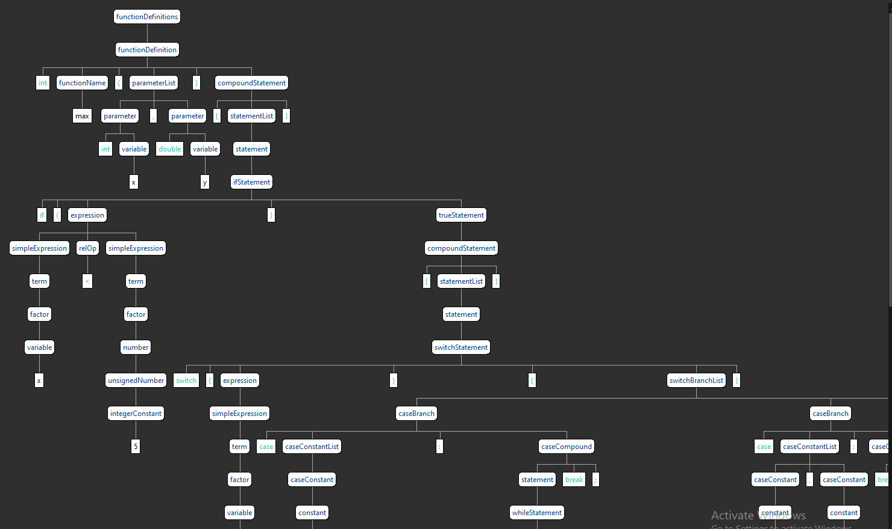
Sample Program
A simple program to demonstrate a few of the control statements of our language. Partial parse tree:
int max(int x, double y){ if(x < 5){ switch (x) { case 1: while(y > 0){ if(y == 1){ print("y"); } else{ print("else"); } } break; case 3,4: break; default: break; } } } int main(){ max(); }
Notes:
Rahul / Caleb

Slide 14

Sample Program
Mandelbrot set
Writing to file
Manipulating array
Notes:
Rahul

Slide 15
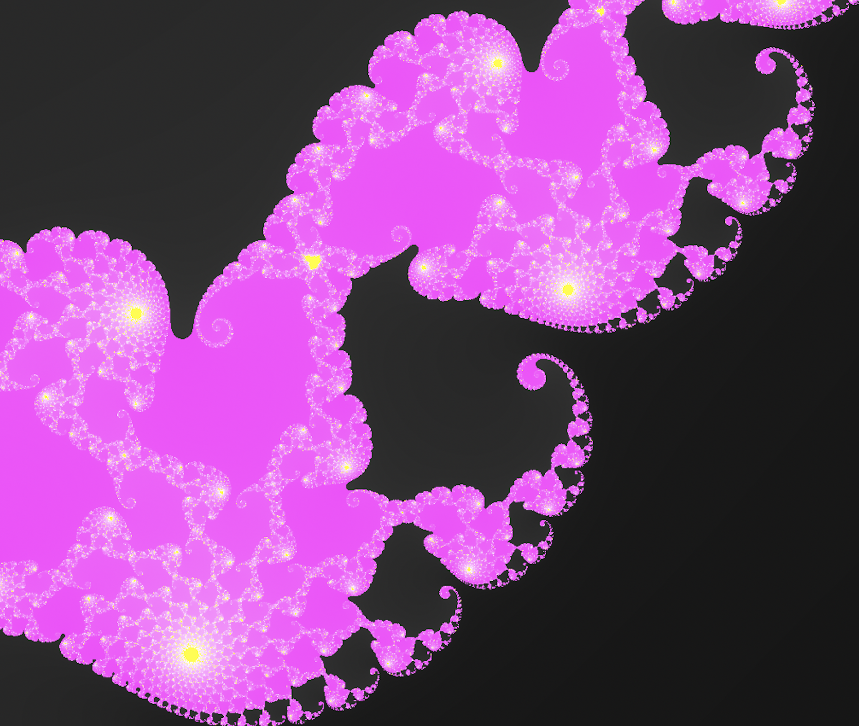
Notes:
Rahul

Slide 16
Challenges
Because we based it off our existing code, it has been a challenge figuring out what we can reuse, what we can quickly change, and what we need to recreate entirely.
For instance, the semantics.java file in our frontend still needs a lot of work, as every minor change we make to the grammar requires us to rewrite code we were previously given.
As a result, a lot of time was spent fixing all the compiler errors that arose by using a new grammar for the existing Pascal compiler.
Time constraints have also been an issue, as we have all had large projects in other classes to finish around this time.
Notes:
Neil

